Slide 1
June 2014
Evaluating Collective Impact:
Assessing Your Progress, Effectiveness, and Impact

Slide 2

Today’s Agenda
Welcome
  Jennifer Juster, Collective Impact Forum
Context for the Guide to Evaluating Collective Impact
  Hallie Preskill, FSG
Overview of Evaluating Collective Impact
  Marcie Parkhurst, FSG
Learning from the Road Map Project
  Mary Jean Ryan, Community Center for Education Results
  Christopher Mazzeo, Education Northwest
  Road Map Project Q&A (Moderated by Hallie Preskill, FSG)
Learning from the Infant Mortality Initiative
  Kathleen Holmes, Missouri Foundation for Health
  Jewlya Lynn, Spark Policy Institute
  Infant Mortality Initiative Q&A (Moderated by Hallie Preskill, FSG)
General Q&A (Moderated by Hallie Preskill, FSG)
Collective Impact Forum Information and Close
    Jennifer Juster, Collective Impact Forum
#collectiveimpact
#evaluation

Slide 3


The Guide to Evaluating Collective Impact Offers a Way to Think About, Plan for and Implement Evaluation and Performance Measurement Activities
Why did we write the guide?
Who is the guide for?
Demand has grown for an effective approach to evaluating collective impact that meets various parties’ needs
Collective impact practitioners, funders, evaluators, and other supporters

Slide 4
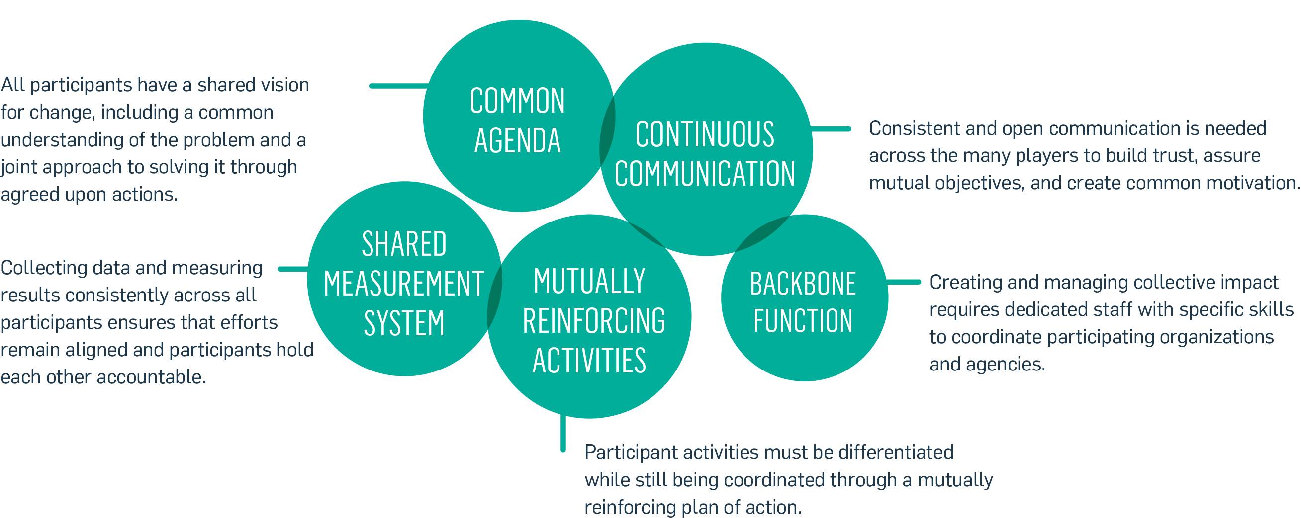
Collective Impact Is an Effective Approach to Addressing
COMPLEX Problems
The Five Conditions of Collective Impact

Slide 5
Evaluating Collective Impact Requires a Mindset Shift for Many Funders and Practitioners
Typical Focus of
Program Evaluation
Evaluating CI as a Complex Intervention
Assessing the impact of a
specific intervention
Assessing multiple parts of the system, including its components and connections
Evaluating effects and impact
according to a predetermined set of outcomes
Evaluating intended and unintended outcomes as they emerge over time
Using logic models that imply cause and effect, and linear relationships
Evaluating non-linear and non-directional relationships between the intervention and its outcomes
Providing findings at the end of the evaluation
Embedding feedback and learning through the evaluation

Slide 6
Collective Impact Efforts Should Use Both Shared Measurement and Evaluation to Understand Their Effectiveness and Impact
Evaluation refers to a range of activities that involve the planned, purposeful, and systematic collection of information about the activities, characteristics, and outcomes of a CI initiative
Evaluation
Shared Measurement
Systems
(SMS)
Shared measurement systems (SMS) use a common set of indicators to monitor an initiative’s performance and track its progress toward goals
SMS can be both an input to evaluation (by providing data and/or shaping evaluation questions) and an object of evaluation

Slide 7
Evaluating a Collective Impact Effort Involves Looking at Four Aspects of the Work
For example…
The initiative’s context
1
Community culture and history
Demographic and socio-economic conditions
Political context
Economic factors
The CI initiative itself
2
…the effectiveness of
The five core elements of collective impact
The initiative’s capacity
The initiative’s learning culture
The systems targeted by the initiative
…changes in:
Individuals’ behavior
Funding flows
Cultural norms
Policies
3
The initiative’s impact
4
…changes in:
Population-level outcomes
The initiative’s (or community’s)
capacity for problem-solving

Slide 8
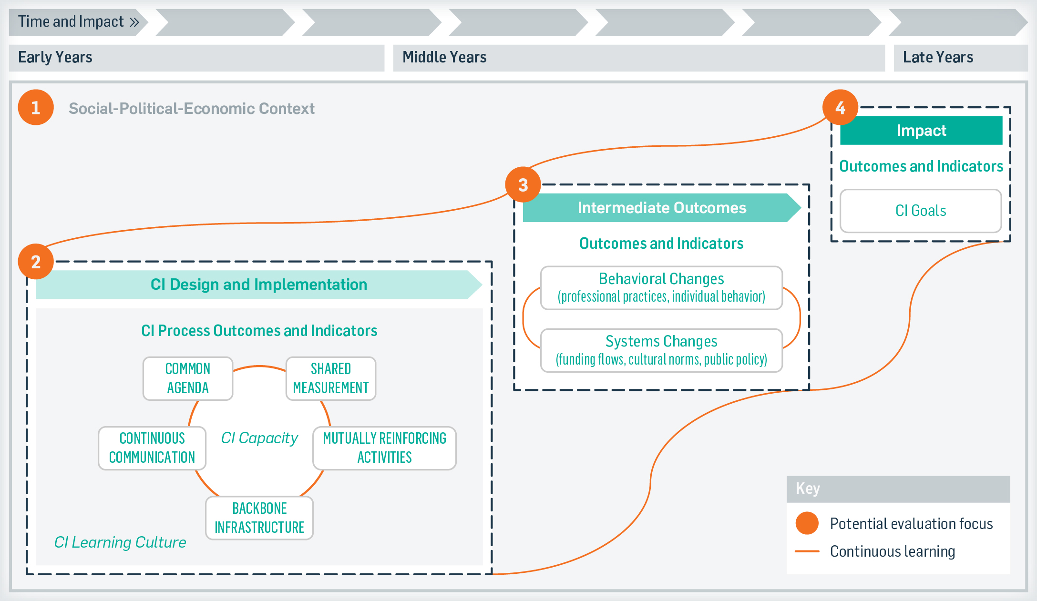
Collective Impact Theory of Change

Slide 9
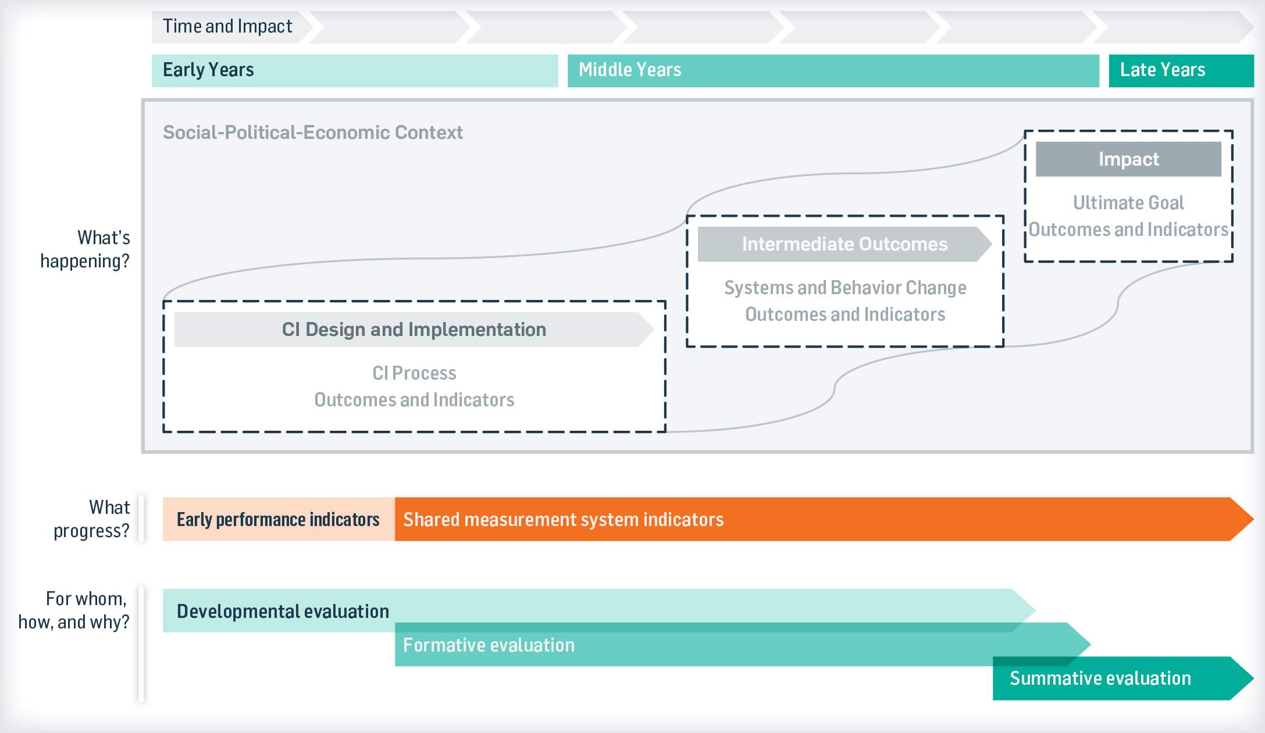
The Focus of Evaluation – and the Data Collection Methods Used – Will Evolve Throughout the Life of the Collective Impact Initiative
CI partners can use the framework to help focus their evaluation

Slide 10
Collective Impact Partners Should First Identify the Key Learning Questions They Seek to Answer
Sample Learning Questions
1
Context
CI Design & Implementation
2
What are the cultural, socioeconomic, and political factors that are influencing the design and implementation of the CI initiative?
Backbone Infrastructure
To what extent and in what ways is the backbone infrastructure providing the leadership, support, and guidance partners need to do their work as planned?
Intermediate Outcomes
3
Impact
4
Changes in Systems
To what extent / in what ways are flows of philanthropic/ public funding shifting to support the goals of the CI initiative?
To what extent / in what ways are social and cultural norms evolving in ways that support the goals of the CI initiative?
To what extent has the CI initiative achieved its ultimate outcomes?
What has contributed to or hindered the achievement of the CI initiative’s goals?

Slide 11
Example: Outcomes and Indicators
Backbone Infrastructure
Learning Question: To what extent, and in what ways is the backbone providing the leadership, support, and guidance partners need to do their work as planned?
Sample Outcomes
Sample Indicators
The backbone infrastructure (BBI) effectively guides the CI initiative’s vision and strategy
BBI builds and maintains hope and motivation to achieve the initiative’s goals
BBI celebrates and disseminates achievements of CI partners internally and externally
Partners look to the BBI and SC for initiative support, strategic guidance and leadership
The backbone infrastructure ensures alignment of existing activities, and pursuit of new opportunities, toward the initiative’s goal
BBI provides project management support, including monitoring progress toward goals and connecting partners to discuss opportunities, challenges, gaps, and overlaps
BBI convenes partners and key external stakeholders to ensure alignment of activities and pursue new opportunities

Slide 12



Key Takeaways
1
2
3
Embed evaluation in the initiative’s DNA
Set reasonable expectations
Be thoughtful about your evaluation partners

Slide 13

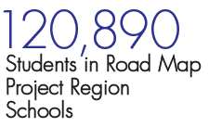


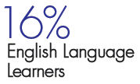

The Road Map Project
Overview
The Road Map Project is a collective impact initiative aimed at getting dramatic improvement in student achievement – cradle through college/career in South Seattle and South King County.

Slide 14
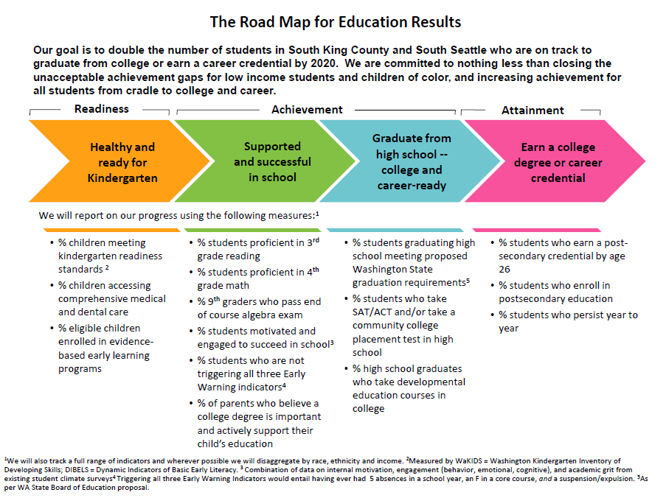
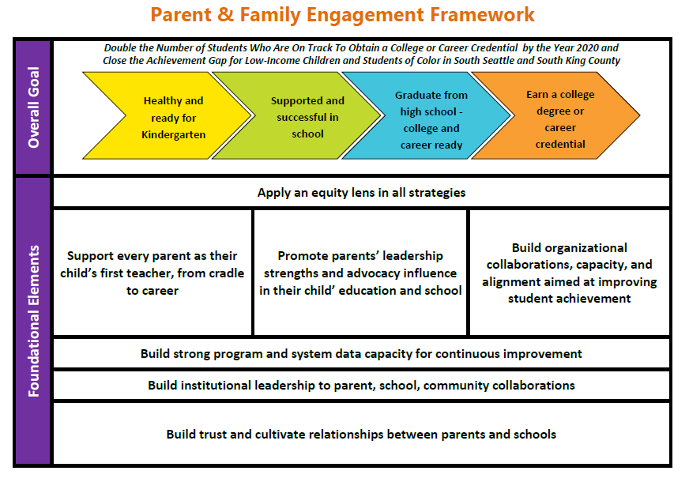
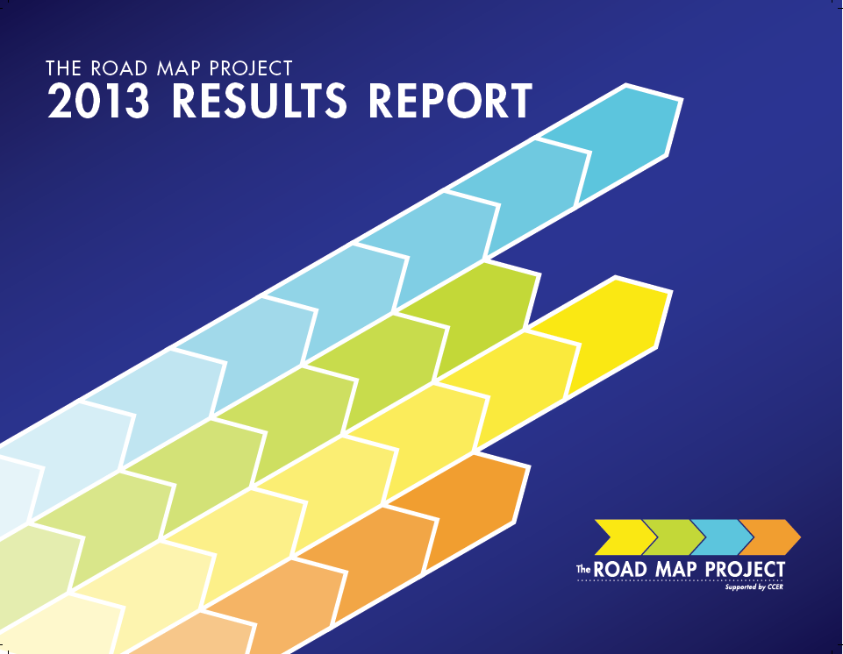
The Road Map Project
Indicators of Student Success, Action Plans, and Tracking Progress

Slide 15

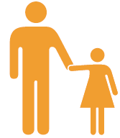


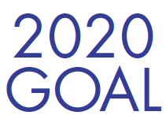
The Road Map Project
How Do We Reach the Goal? Collective Action at Work
Alignment
Parent &
Community
Engagement
Power of Data
Stronger Systems

Slide 16

The Road Map Project
Evaluation Questions
How is the Road Map Project being implemented on the ground?
  Role of various partners and regional organizations
  Plans and actions of key workgroups
  Supports provided by the backbone organization
In what ways does the Project use its core strategies (alignment, engagement, data) to catalyze systems change in the region?
What systems changes are occurring within and across organizations and the region as a result of Road Map?

Slide 17
The Road Map Project
Key Findings
Alignment
  Partners are beginning to align their policies, practices and funding decisions with Road Map goals and indicators
Engagement
  Knowledge and buy-in for the Road Map goal is very high
  There is “more work to be done” to ensure all stakeholders are meaningfully engaged
Data
  There has been tremendous success in building data capacity and adopting common metrics across organizations in the region
Stronger Systems
  There has been a substantial increase in collaboration both within and across sectors
Notes:
Aligned Organizational Actions. Increasing commitment to the Road Map goal and targets from education institutions, youth development organizations, and other key stakeholders. Significant alignment of work among the major implementing organizations.
Policies are changing among key organizations and partners
Districts, CBOs, and funders are aligning their metrics and programmatic work with Road Map indicators and action plans
Progress: Institutional leaders within key sectors are aware of RMP, support the RMP goal, and demonstrate commitment by investing in RMP strategies and aligning with RMP indicators
Stakeholders reported that RMP is becoming part of the culture of South King County, in that many leaders across these core sectors are involved in the project
Organizations and institutions are taking action to align with RMP goals, indicators and strategies
Progress: There is more explicit focus on parent engagement across the Road Map sectors and organizations
Organizations are beginning to re-think parent and community engagement strategies, especially school districts
There are more public events that promote engagement, and the Parent Forum is seen as a significant accomplishment
B3 work
Progress: Efforts to build data capacity have been highly successful to date
Development and adoption of a common set of measures and indicators across organizations
Districts, post-secondary institutions, funders, and CBOs are increasingly all using Road Map indicators to track progress and make decisions
YDEKC work developing “non-cognitive” indicators has enabled CBOs to better describe their work and its relevance and align efforts with each other and with schools
Types of data successes mentioned
Alignment around indicators and measures, both within and across sectors (you got this)
Increased availability of demographic/school performance data from a regional lens through CCER
Use of real-time process data to inform practice (e.g. college bound scholarship numbers driving competition between schools)
Facilitating data sharing agreements between CBOs and schools

Slide 18
The Road Map Project
CCER Reflections on Evaluating the Road Map Project
Evaluation Finding | Response
Strong, broad support for 2020 Goal | 2020 Goal stays front and center
Continuous communication: Improve communication and engagement options | Better Connections: new newsletter, RMP 101 events, strategic communication plan More Voices: Leadership group expansion, advocacy re-organization
Common agenda: Increase focus on equity and inclusion | Reporting framework changed Awards program explicit about equity Results Roundtables for Race/Ethnic groups
Shared measurement system: provide more detail and actionable data | District Briefings with new data Results Roundtables bring data to community groups High School-specific reports
Future evaluation efforts will focus on scale and sustainability
Notes:
One example of this is checking to see if our communication and involvement activities have resulted in stronger engagement for our stakeholders. We can go deeper to look at particular stakeholder groups that were interested in increased involvement and decision-making in the original survey to determine if results for those groups have changed.

Slide 19
The Road Map Project
Education Northwest Reflections on Evaluating Collective Impact
Be prepared to adapt…and then adapt again
Formative evaluation requires significant capacity-building work with the backbone organization to be of greatest use
Shared measurements systems need to be complemented with more fine grained data collection efforts to promote continuous improvement
Be mindful of what audience(s) the evaluation is for

Slide 20
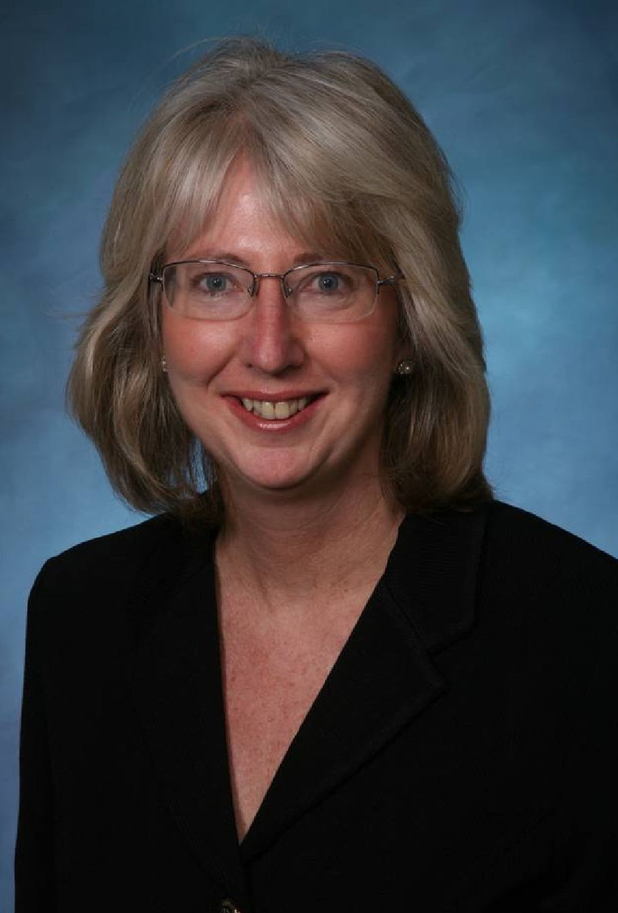
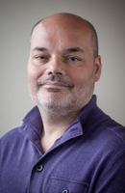

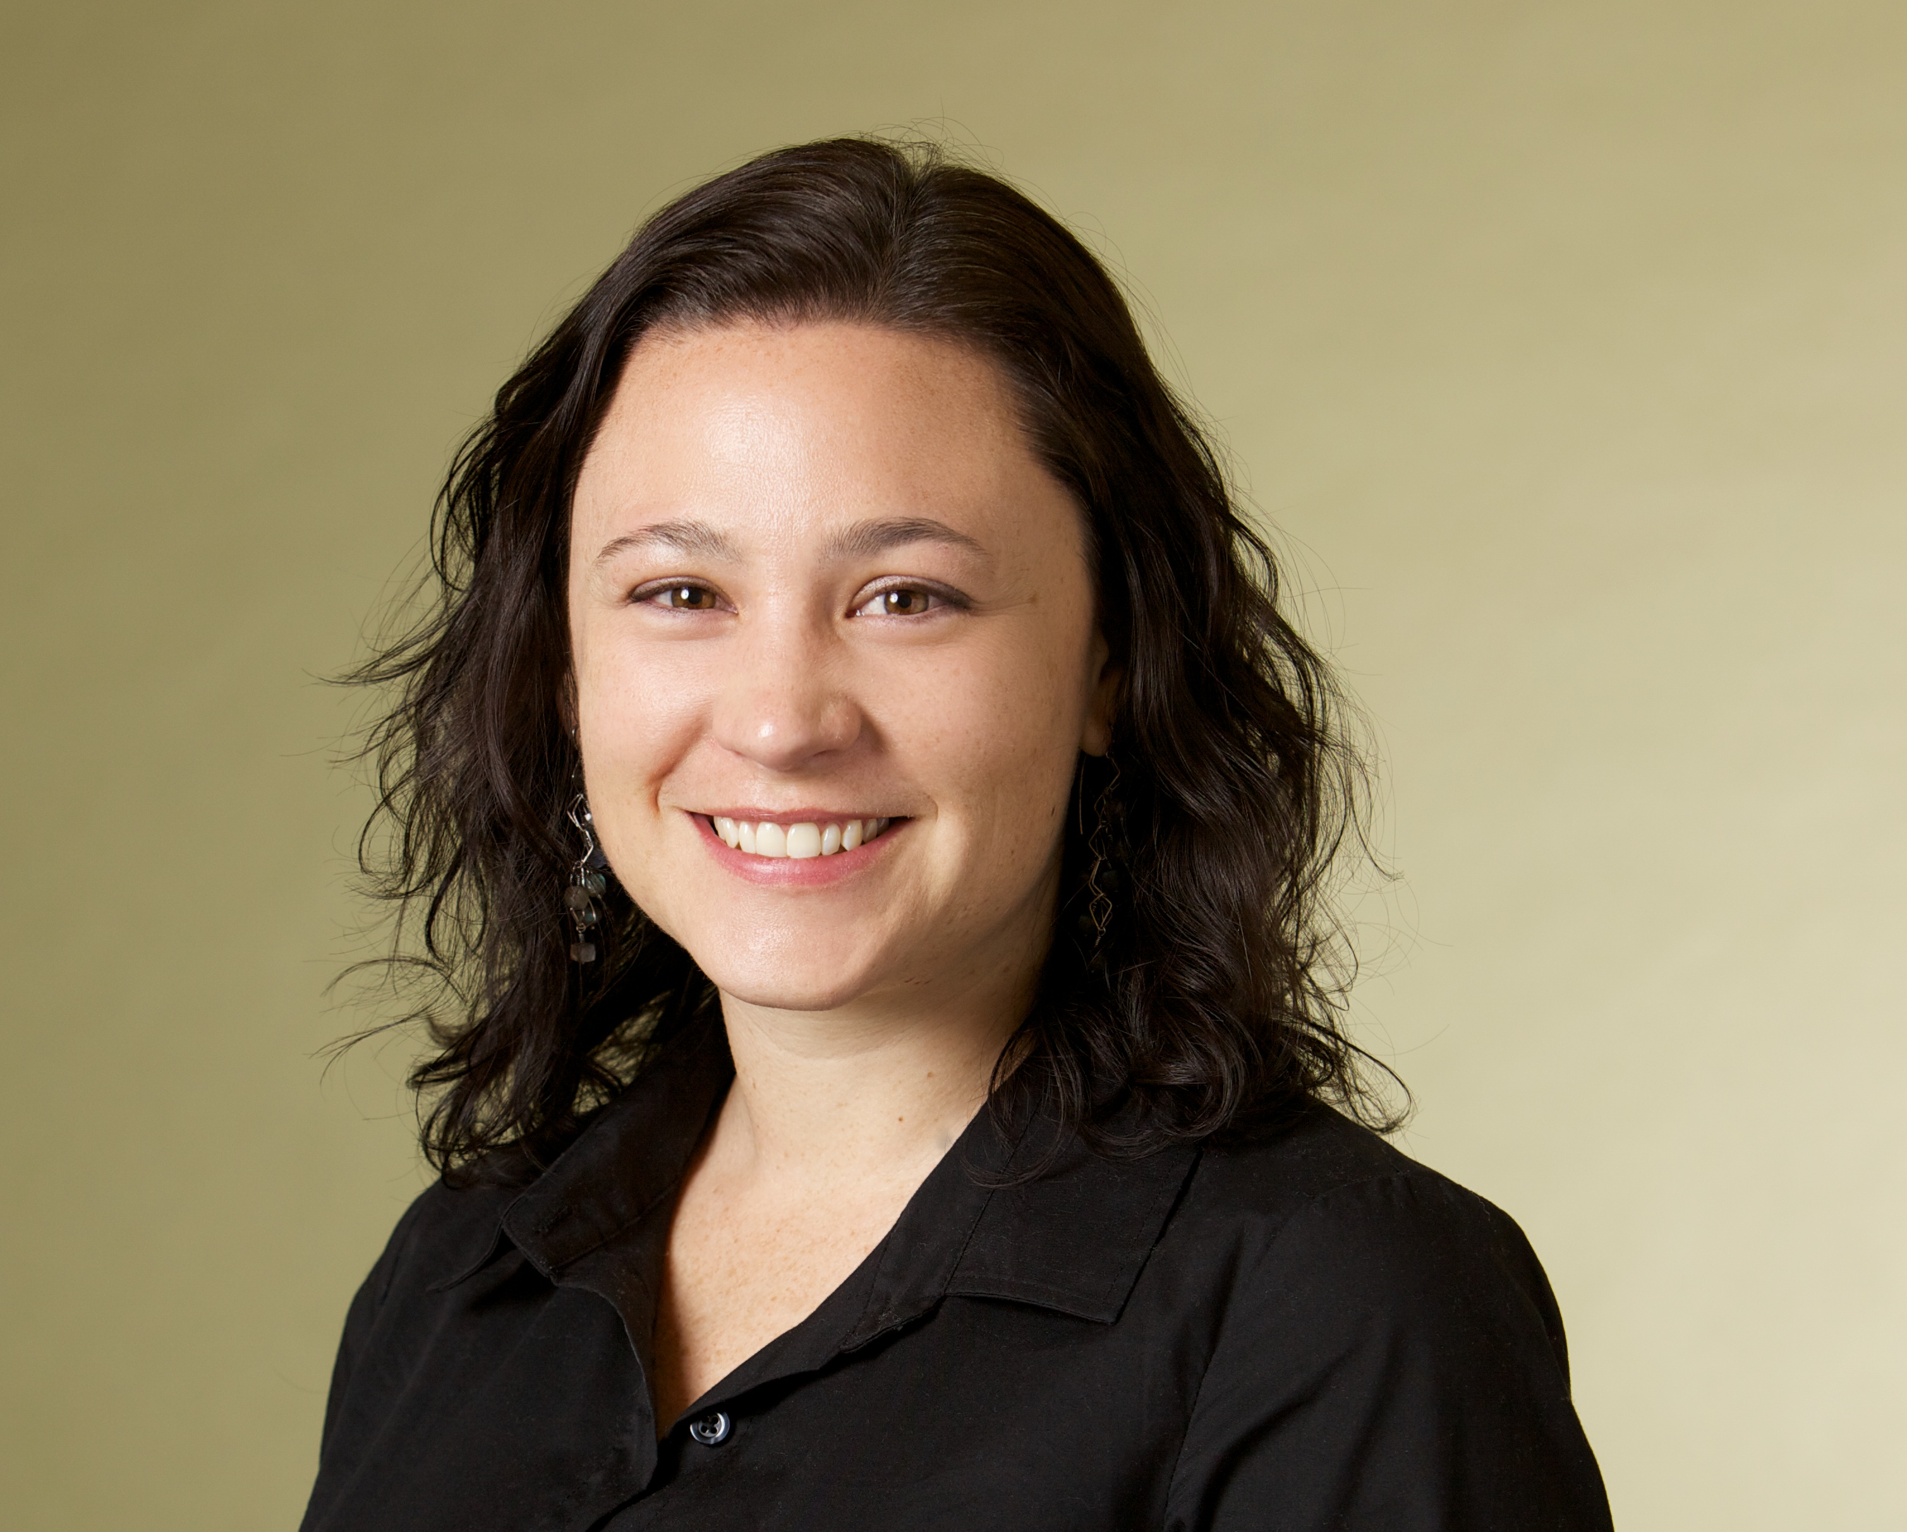
The Road Map Project
Q&A
Mary Jean Ryan
Community Center for Education Results
Christopher Mazzeo
Education Northwest
Hallie Preskill
FSG

Slide 21


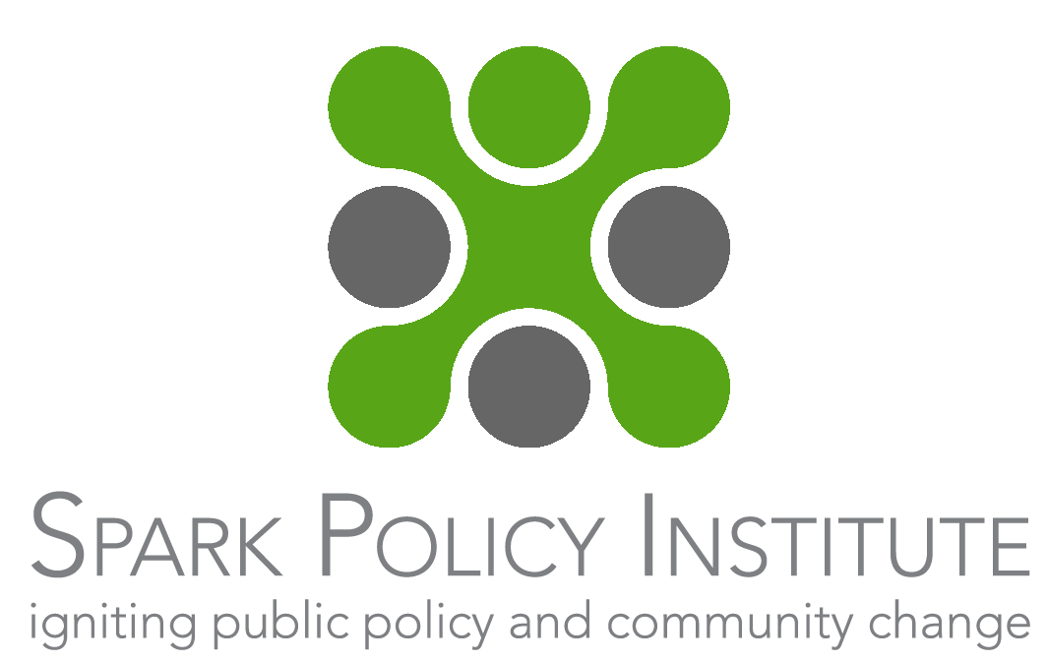
The Infant Mortality Initiative
Overview
Every year in the state of Missouri, approximately 600 babies do not live to see their first birthday.
Initiated by the Missouri Foundation for Health in 2013 with two sites:
St. Louis:
One organization serving as the backbone in a community with many other collective impact initiatives.
Bootheel:
Two organizations coming together in a new partnership to share the role of a backbone in a community with little prior experience with collective impact.
Supported by developmental evaluation from the beginning
Notes:
Brief overview of the Initiative:
Every year in the state of Missouri, approximately 600 babies do not live to see their first birthday. The rate at which babies are dying is highest among the state’s large African American population, nearly double the rate among non-Hispanic white infants. About one third of all infant deaths occur in two areas of the state: the city of St. Louis, and an area called the Bootheel, which includes the state’s six southeastern-most counties.
In 2012, MFH prioritized infant mortality as one of its four “targeted” funding areas, and decided to focus its efforts in two distinct regions: St. Louis (an urban city) and the Bootheel (a rural region).
The need to address the rate of infant mortality in these two communities was already well-known; many local nonprofits, hospitals, universities, and other institutions were administering small-scale programs. The problem, of course, was that these many one-off programs were not adding up to substantial change.
MFH decided a new approach was needed, and committed to funding the design and launch of collective impact initiatives in each of its targeted communities.
Brief overview of the Initiative – site level:
In St. Louis, MFH provided a planning grant to a well respected coalition that understood the maternal and child health issues in the community.
In the Bootheel region, MFH’s first step was to provide a planning grant to two organizations involved in infant mortality work.
These grantees, who have a history of working on the same issues in the same place, but not necessarily in the same way, were encouraged to co-create the emergent CI initiative’s backbone infrastructure and begin laying the groundwork for development of a Common Agenda.
Brief overview of how the initiative thought about evaluation
To support its grantees in developing a CI initiative, MFH has made available a range of resources, including a public health expert, who offers content-based technical assistance; a learning coach, who provides training, workshops, and site visits to build grantees’ skills, capacities, and knowledge-base; and two developmental evaluation (DE) coaches from the Spark Policy Institute and the Center for Evaluation Innovation.
The DE coaches support MFH program staff and grantees in using DE to improve the design and implementation of their emergent CI initiatives.
The foundation’s intention in the use of DE coaches, rather than dedicated evaluators, was to build the capacity of MFH staff and Bootheel grantees to use DE on their own in the initiative’s later years.
Transition to next slide and Jewlya speaking

Slide 22
The Infant Mortality Initiative
Overview of the Developmental Evaluation Process
Recognizing that DE looks different
Supports innovation and ongoing development of new approaches
A great fit for collective impact in its early years, when the level of uncertainty is high
1
Coaching for the Foundation
2
Twice monthly coaching calls
Building understanding of the DE approach
Developing specific learning skills
Training and support for the Grantees
3
Building understanding of the DE approach
Working together to understand what about their work is simple, complicated and complex
Generating evaluation questions ongoing with the grantees
Exploring the types of questions DE can help answer
Developing evaluation questions together
Helping to answer the questions through data collection
4
Notes:
Focus of the Evaluation
Developmental evaluation is a great fit for collective impact in its early years, when the partners are still assembling the key elements of their work, developing action plans, identifying initial partners.
Perhaps more so than at any other time in collective impact initiatives, this is when participants will fill a sense of uncertainty about what can be accomplished through this work and equal uncertainty about which road is the right road ahead. Early in a CI effort, evaluation focuses on the context and the initiative itself.
Key Learning Questions
Developmental evaluation functions a little differently from formative and summative evaluation. Instead of pre-defined evaluation questions with accompanying outcomes and indicators, the developmental evaluator role is to help surface issues in a timely manner, using data and insight to bring new information into the dialogue and facilitate the learning process.
Rather than telling you about what is working, it helps to answer – what should we do next? How can we do this in a way that will work best?
Coaching Approach
With the Infant Mortality Initiative, because we were using a capacity building approach to developmental evaluation, we did a couple things that were different from being the typical developmental evaluation.
We began with training and capacity building for the Foundation staff through twice monthly coaching calls and introduced the concepts of developmental evaluation to the backbone organizations at their first joint backbone meeting.
By the second meeting, we worked with backbones to assess the issue of infant mortality and breakdown what elements of the problem were simple, which were complicated, and what was complex, helping to focus the developmental evaluation attention on those areas with the greatest uncertainty.
We introduced the backbone and foundation staff the types of questions that are often surfaced in developmental evaluation and then together we collectively generated questions related to the most pressing uncertainties in each site.

Slide 23
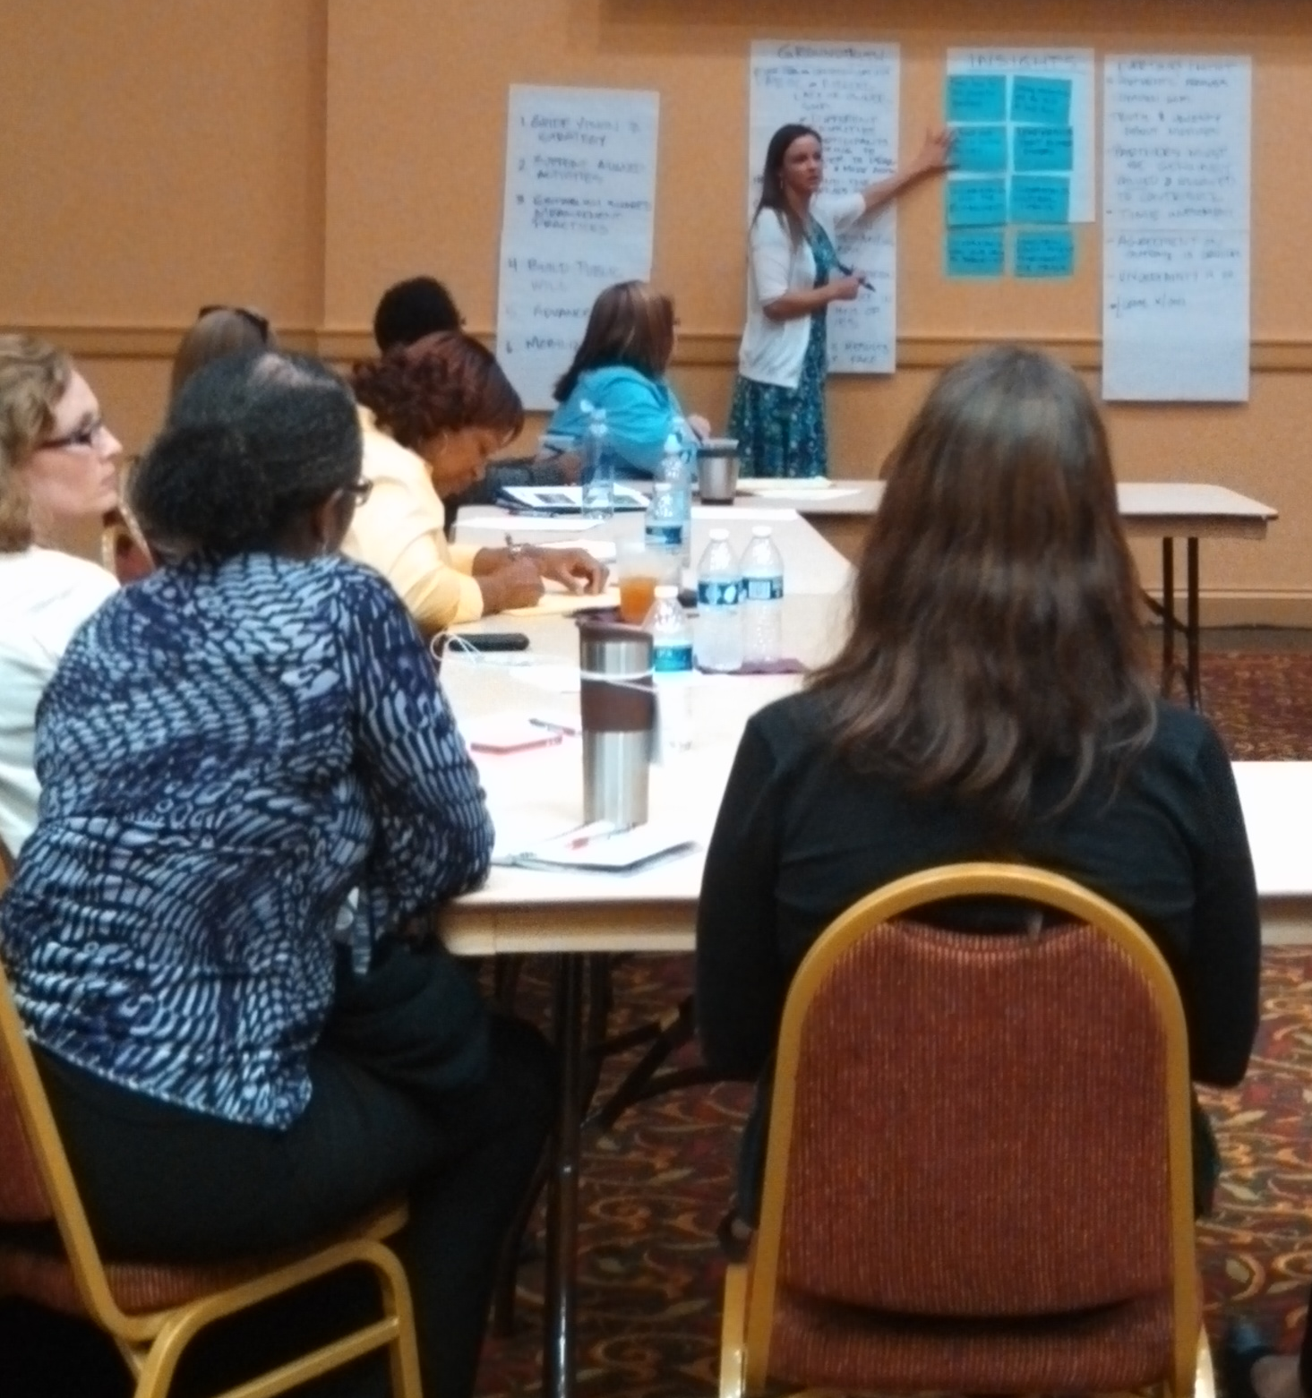
The Infant Mortality Initiative
Evaluating the Initiative
Learning Questions in St. Louis:
How can outside influences be harnessed to develop the strategy in new ways?
What is a process and structure for engaging stakeholders, including how to best stage the engagement and how to motivate participation?
Learning Questions in the Bootheel:
What does the problem of infant mortality look like from the perspective of different stakeholders in our region, including within the two different grantee organizations?
How can the two backbones work together, leveraging separate strengths and taking on distinct, yet complimentary, roles?
Notes:
With the questions in hand, we worked with each site to craft and implement a data collection strategy and shared preliminary results. Both sites took on the use of the information themselves – presenting and using it at their meetings, rather than handing that role over to an evaluator.

Slide 24
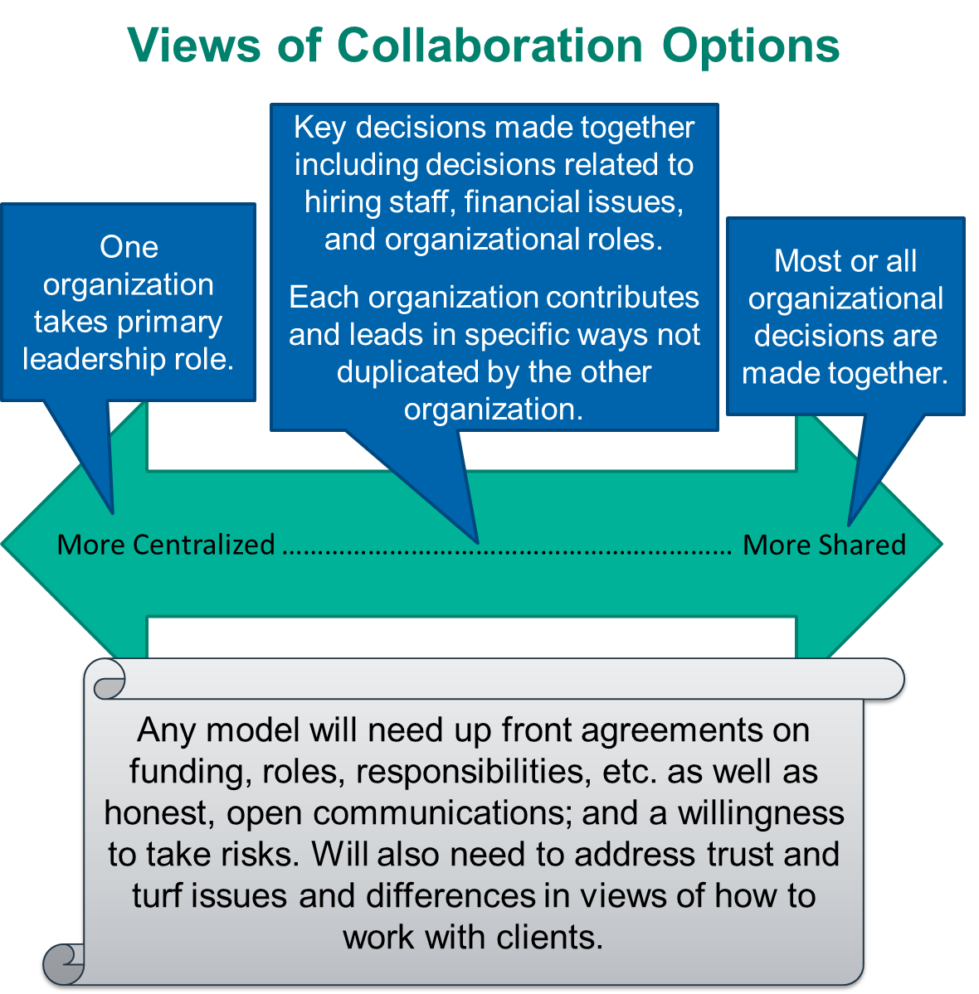
The Infant Mortality Initiative
Sample of the Findings
Notes:
This ownership of their data is an important part of the learning process being the work of the backbones, supplemented by an evaluator, but not led by the evaluator.

Slide 25
The Infant Mortality Initiative
Reflections on Evaluating the Initiative
Bootheel Learning
Understanding strengths and areas for growth in the relationships between the two backbone organizations
St. Louis Learning
Understanding messaging and engagement strategies that will resonate with stakeholders
Foundation Learning
Understanding when and how to use developmental evaluation in the context of collective impact and beyond
Notes:
What did you learn about this initiative from this evaluation?- Jewlya
Bootheel: We learned together about relationships, surfacing underlying dynamics, ownership of the data, trust. The Bootheel learning was an example of developmental evaluation surfacing an uncomfortable, underlying set of dynamics to put the issues on the table.
St. Louis: We learned how to better message and engage stakeholders across many different sectors, where the enthusiasm is for the work. The St. Louis learning was an example of how Developmental Evaluation can be anticipatory, helping St. Louis to think more broadly about range of ways to engage in stakeholders, and filling a gap that another initiative might not have – in this case, doing the research that a communications consultant might do if they were part of the work
Also internal learning happening in the Foundation (the use of before and after action reviews, a skillset available in any work, not just this initiative - example of using BAR to design joint backbone meetings)
Transition to next slide and Kathleen as the speaker

Slide 26
The Infant Mortality Initiative
Reflections on Evaluating the Initiative
Learning about Developmental Evaluation
There is a learning curve!
The flexibility of developmental evaluation is critically important early in a collective impact initiative
Coaching Model
Coaching helps build capacity, but sometimes the embedded, on the ground evaluator is needed
Coaching calls with the Foundation have value at multiple levels
Future Plans
Local embedded evaluators supported with coaching and training
Notes:
What did you learn about the process of evaluating collective impact? - Kathleen
It's hard! There is a learning curve for the people using developmental evaluation, both Foundation staff and grantees. But, because there is so much going on in developing CI, theoretical basis isn't what they care about, it's the practicality of it
The flexibility of developmental evaluation is critical. Six months ago, we would not known the issues we’re facing now would be our most complex and uncertain issues. Developmental evaluation can keep up with what is changing and help us along the way.
What were challenges that you faced? - Kathleen
Coaching model, while it helps build capacity and expand understanding of where to use developmental evaluation, the reality on the ground is that the grantees need someone embedded to help them surface issues, rather than someone external they need to check-in with. There isn't space in the collective impact start-up to engage in learning in the way you might in a less intensive, complex start-up.
What worked particularly well with your approach? - Kathleen
Coaching calls with the Foundation
Common language, foundation around what DE can accomplish, because we did the early coaching
Ongoing coaching calls helps with staying closely connected at a foundation level
What are your future plans? – Jewlya
Working with the Foundation, we have expanded the model for the second year of the initiative. Now that everyone has a base understanding of developmental evaluation and some practice using it to inform their work, we’re going to start building local capacity through working with two Missouri evaluators.
Spark will be coaching two evaluators who are new to developmental evaluation to learn the approach and become embedded developmental evaluators in each site. With a common language and an understanding by both sites and the foundation already established around what developmental evaluation is and what it can accomplish, the barriers to entry for these new developmental evaluators are lower than if they were stepping into the initiative a year ago. The twice a month coaching they will receive along with a full toolbox of practical, hands on resources will help them to take on the new role and approach.

Slide 27
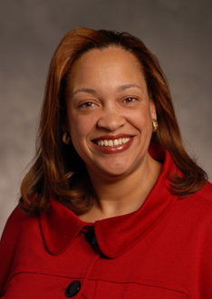
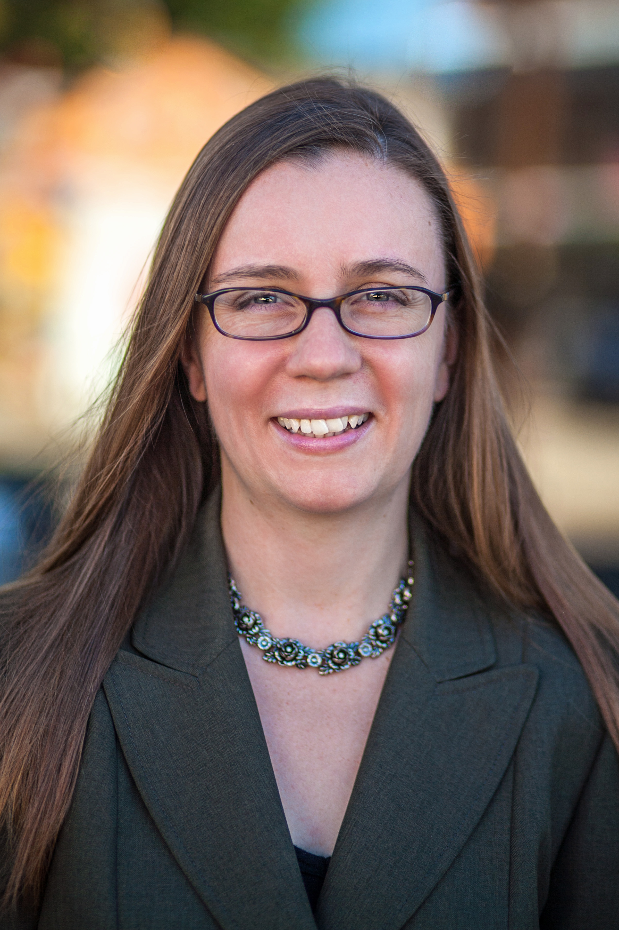
The Infant Mortality Initiative
Q&A
Kathleen Holmes
Missouri Foundation for Health
Jewlya Lynn
Spark Policy Institute
Hallie Preskill
FSG

Slide 28
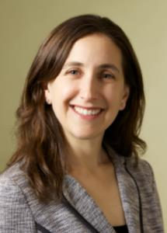
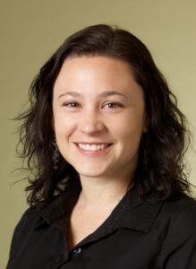
Full Q&A
Christopher Mazzeo
Education Northwest
Kathleen Holmes
Missouri Foundation for Health
Jewlya Lynn
Spark Policy Institute
Jennifer Juster
Collective Impact Forum
Hallie Preskill
FSG
Marcie Parkhurst
FSG

Slide 29

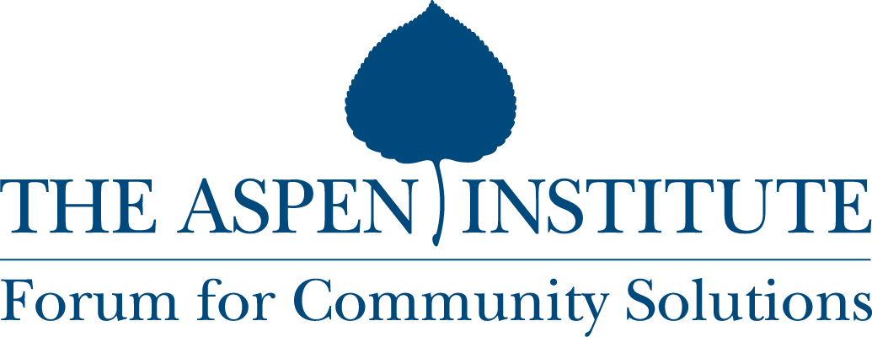

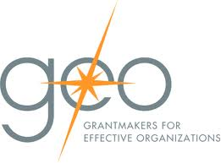



Goals: Create the Knowledge, Networks and Tools That Accelerate the Adoption and Increase the Rigor of Collective Impact
  Activities
Develop a field-wide digital forum to create, curate, and disseminate effective knowledge, tools and practices that support collective impact
Support communities of practice, convenings and other events across the country that enable practitioners and funders of collective impact to increase their effectiveness
  The first two communities of practice are for funders of collective impact, and collective impact backbone organizations
  Partners
  Co-Catalysts

Slide 30
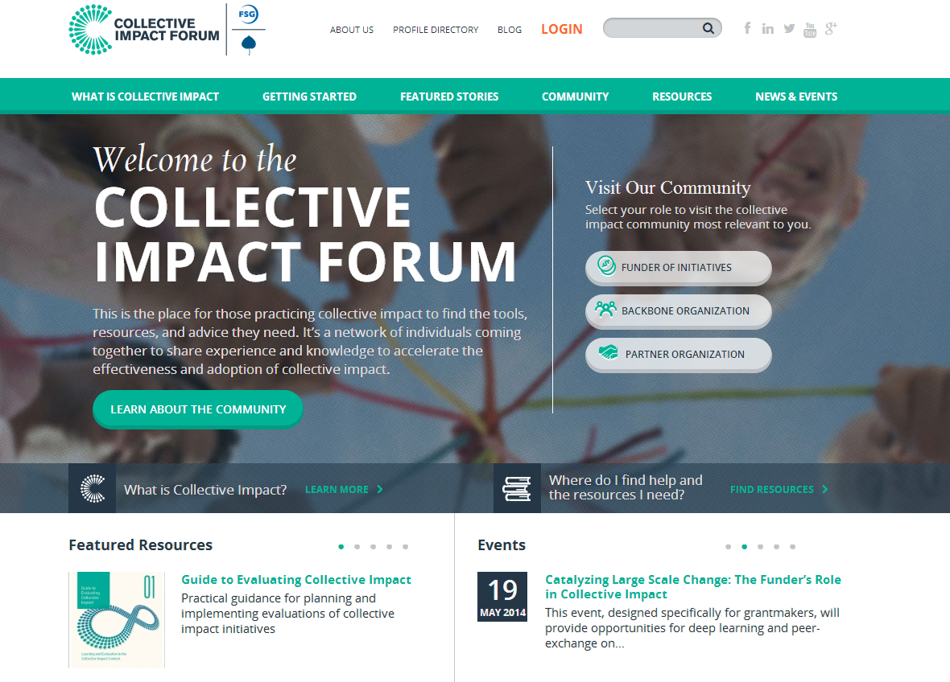
The Collective Impact Forum Will Fill In the Missing Pieces to Meet the Demand of the Field

Slide 31
THANK YOU!
  Thank you for being part of the conversation today
  For additional guidance on this topic, see resources on the Collective Impact Forum website (collectiveimpactforum.org/resources/evaluating-collective-impact-webinar), and take a look at FSG’s Guide to Evaluating Collective Impact on the Forum.
Goals of the Guide
1
Illustrate the general process by which CI initiatives address complex problems
2
Explore the ways in which evaluation and learning support CI success
3
Answer common questions about planning for and implementing evaluation activities

Slide 32
collectiveimpactforum.org

